Slide 1
STRATEGIES FOR
DATA DISSEMINATION
at
Computer Centre
(Ministry of Statistics & Programme Implementation)
Government of India
(Website : http://mospi.gov.in)

Slide 2
GOVERNMENT OF INDIA
Ministry of Statistics & Programme Implementation (MoSPI)
National Statistical Organization (NSO)
Central Statistics Office (CSO)
National Sample Survey Office (NSSO)
Programme Implementation (PI)
COMPUTER CENTRE
(Other Divisions of CSO)

Slide 3
SOFTWARE/OPERATING SYSTEMS:
Sun Solaris on SUN Servers & Windows 2007 on IBM Server
Windows 98/XP/2007/NT
APS-2000, Oracle 10i Developer Suite
MS Office, MS Visual Studio, VB.Net, STATA, SPSS
COGNOS BI tool for Creation of National Data
Warehouse etc.
IHSN Toolkit for Micro Data Dissemination

Slide 4
Data Preservation and Dissemination
The Government of India announced the “National Policy on Dissemination of Statistical Data” in the year 1999.
The Policy designated Ministry of Statistics & Programme Implementation (MoSPI) to function as nodal agency for dissemination of official statistics produced by Central Government Ministries and Department.
As part of the Policy, Computer Centre, MoSPI was identified to function as Data Storage and Dissemination Office

Slide 5
Currently we have both historical and current micro-data stored in magnetic media on different census / sample surveys for dissemination:-
Socio-economic surveys (NSSO)
Economic Censuses
Annual Survey of Industries (ASI)
Price data

Slide 6
CURRENT PRACTICE OF MICRO-DATA DISSEMINATION IN MoSPI
Document-based data dissemination:-
The list of unit-level data available for dissemination for different topics are put up in the Ministry’s website.
The data preserved after disabling the identification of the survey units to maintain confidentiality.

Slide 7
Unit-level data supplied to users after signing a non-disclosure declaration.
Nominal charges are levied from data-users to discourage non-serious users.
The price is at subsidised rate for individual researchers and at further subsidised rate for students enrolled with academic institutions.

Slide 8
Web-based data dissemination-
The National Policy on dissemination of statistical data envisaged creation of a data warehouse to enable the data users and general public to have easy access to the published as well as unpublished validated data in the required form and content from one source.
MoSPI took up creation of National Data Warehouse which is an integrated repository of current and historical
data generated by MoSPI and other Central Ministries to provide remote access facilities to end users through a network.

Slide 9
Data Dissemination through Ministry’s website
Free downloading of publications/reports
Availability of key statistics by sector and subject
Unit level data dissemination to approved users
Data warehouse for internal users
Meta data on unit level data through Toolkit software

Slide 10
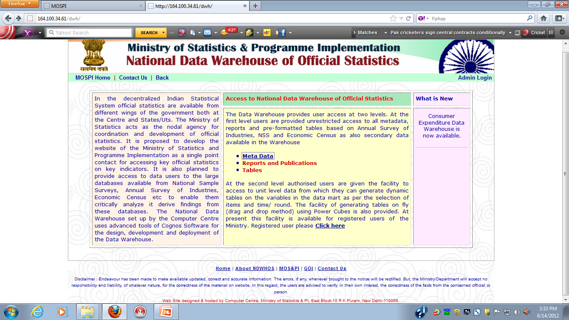
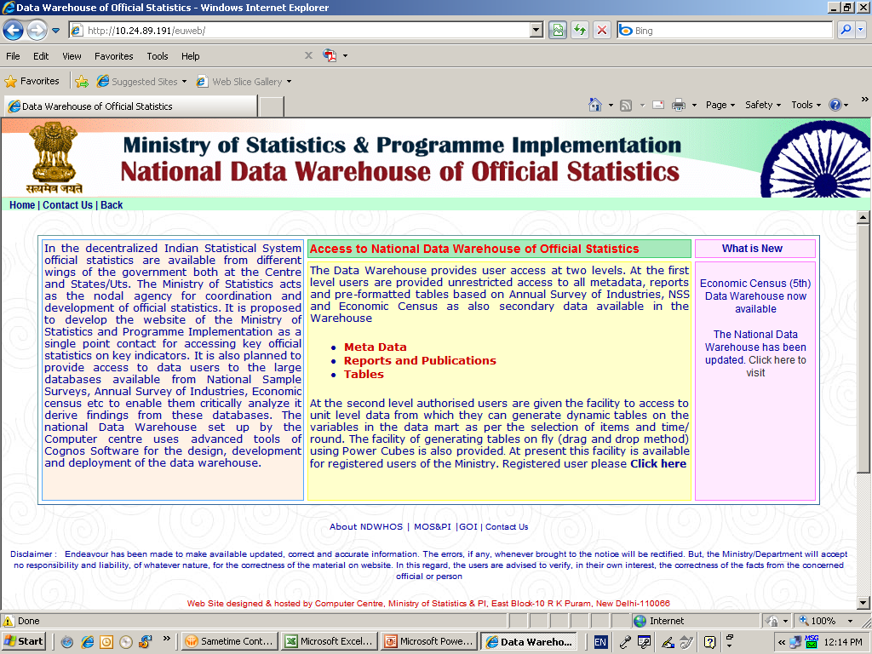
Data Warehouse Page

Slide 11
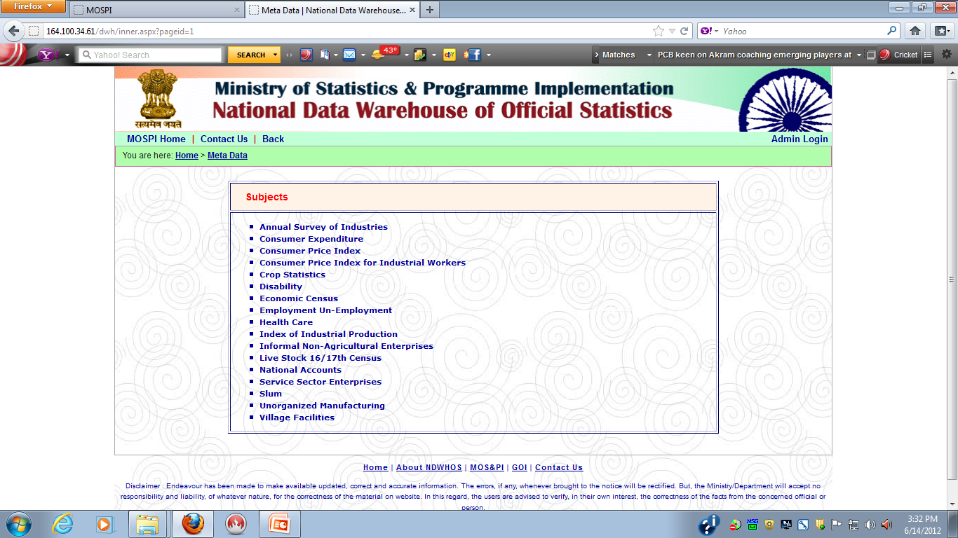
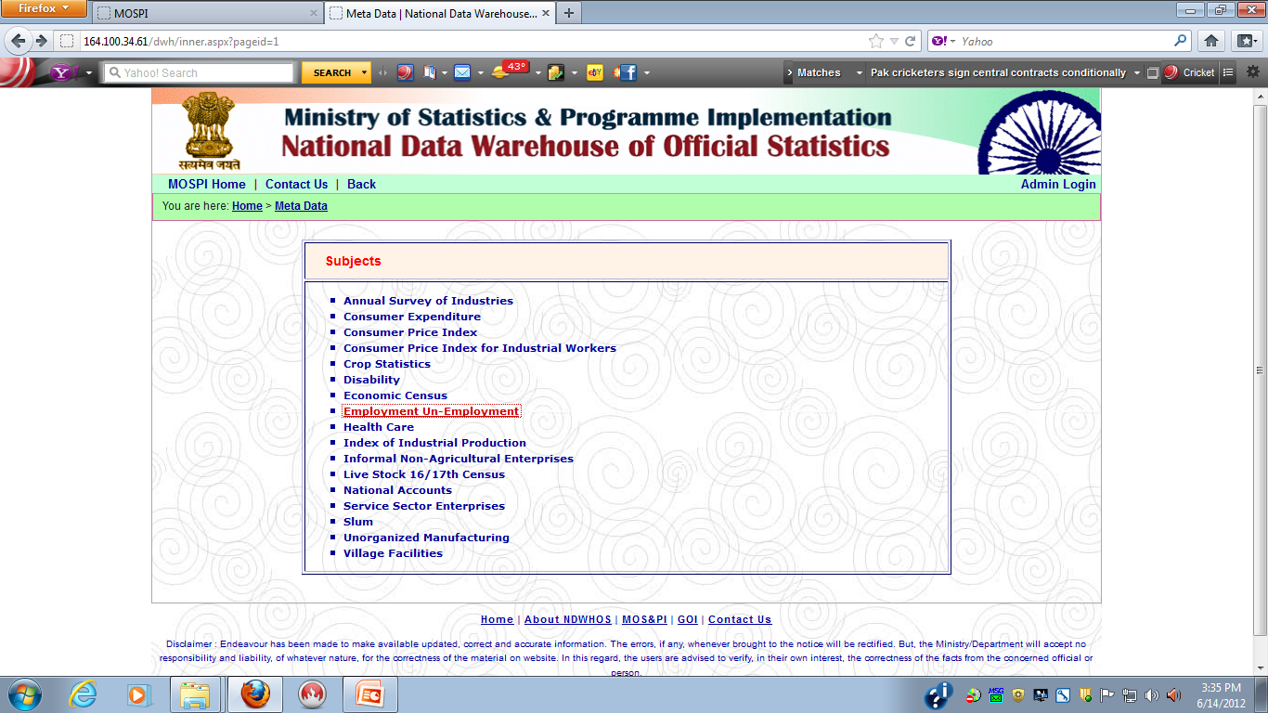
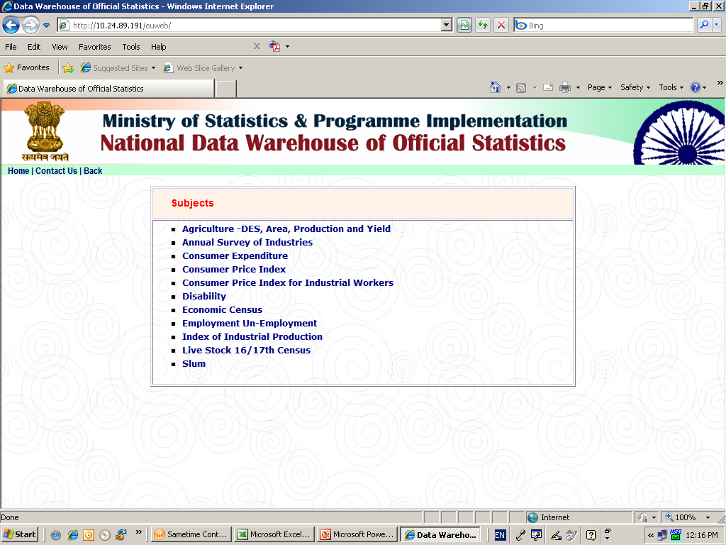

Slide 12
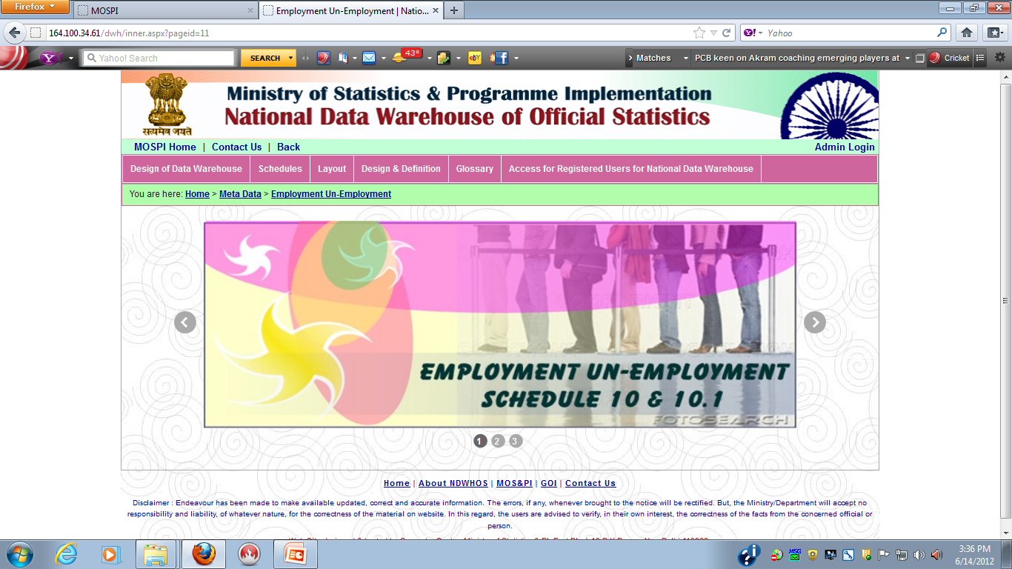

Slide 13
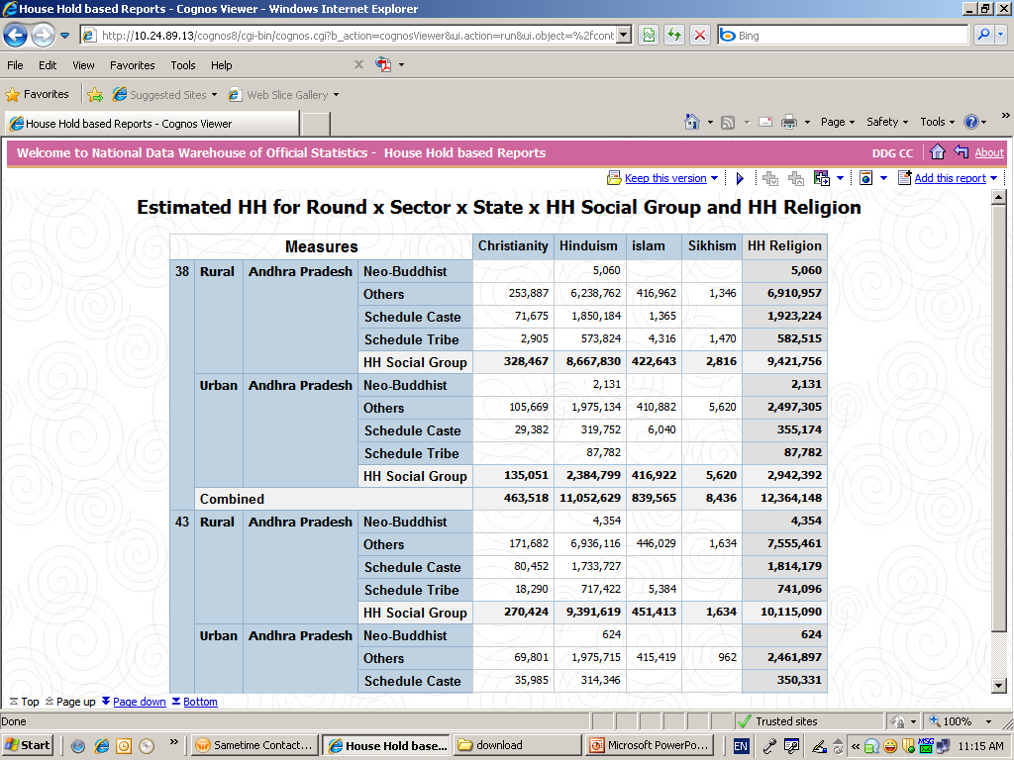

Slide 14
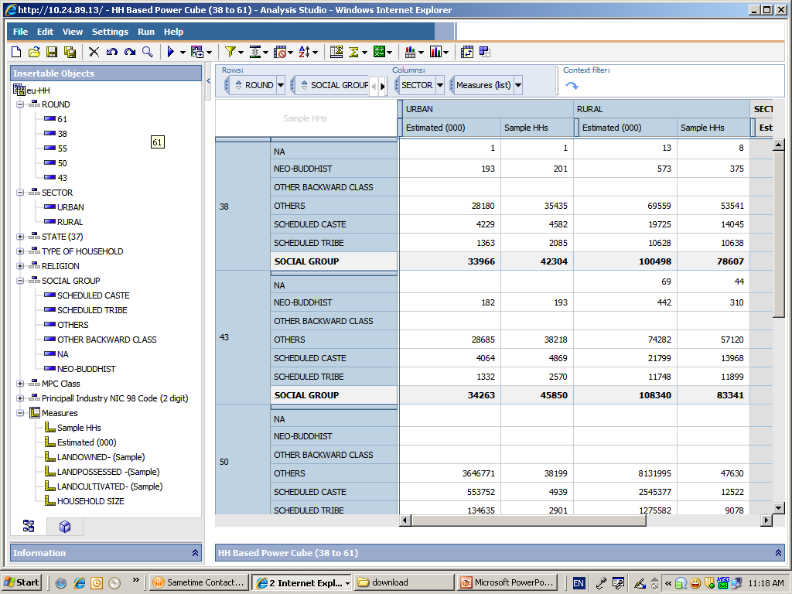

Slide 15
Challenges / Future Plans for the Data Warehouse
Acquisition of new data base not only from other Central Governments Ministries / Departments but also PSU’s, state governments and local bodies and their integration to the existing database in the data warehouse;
Uniform concepts and definitions
Appropriate protocols for data sharing and integration;
Data Warehouse to help in extracting user specified data in user specified formats.
Online supply of unit level data to users.
Create a user forum for sharing of experience in using complex datasets.
Upgrading data warehouse tools.

Slide 16
Dissemination of Metadata through IHSN Toolkit software
Micro data difficult to use without metadata (data about
data /detailed documentation)
For Sample Survey data: Most required information:-
Sample design ( sampling methodology, sampling frame etc)
Survey instruments ( questionnaire, instructions, concepts and definitions etc)
Data collection methodology ( field work, inspection, scrutiny etc)
Data processing ( data editing, validation, data layout etc)
Reports

Slide 17
CATALOGUE METADATA
The Indian Data Archive
The data catalogue under development contains mandatory and optional metadata elements as in DDI.
IHSN is served by a Secretariat managed by the World Bank Development Data Group (in partnership with UNICEF, DFID, SPC, FAO, WFP, others) and the Paris21 at OECD

Slide 18
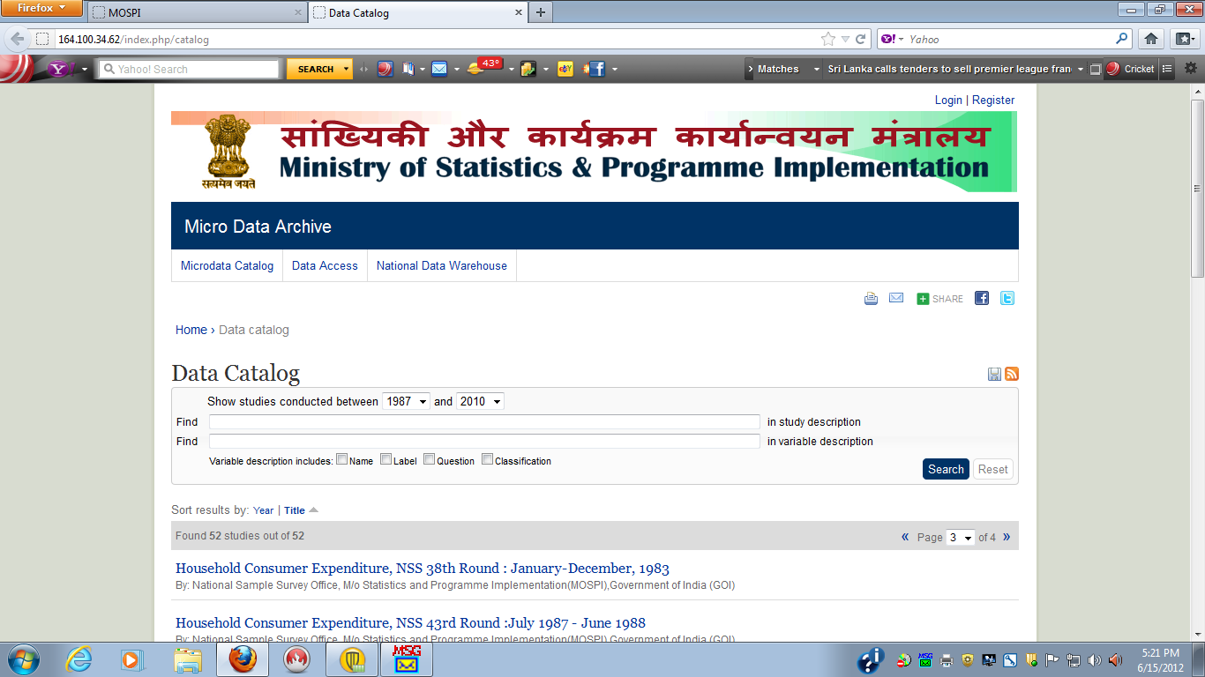

Slide 19
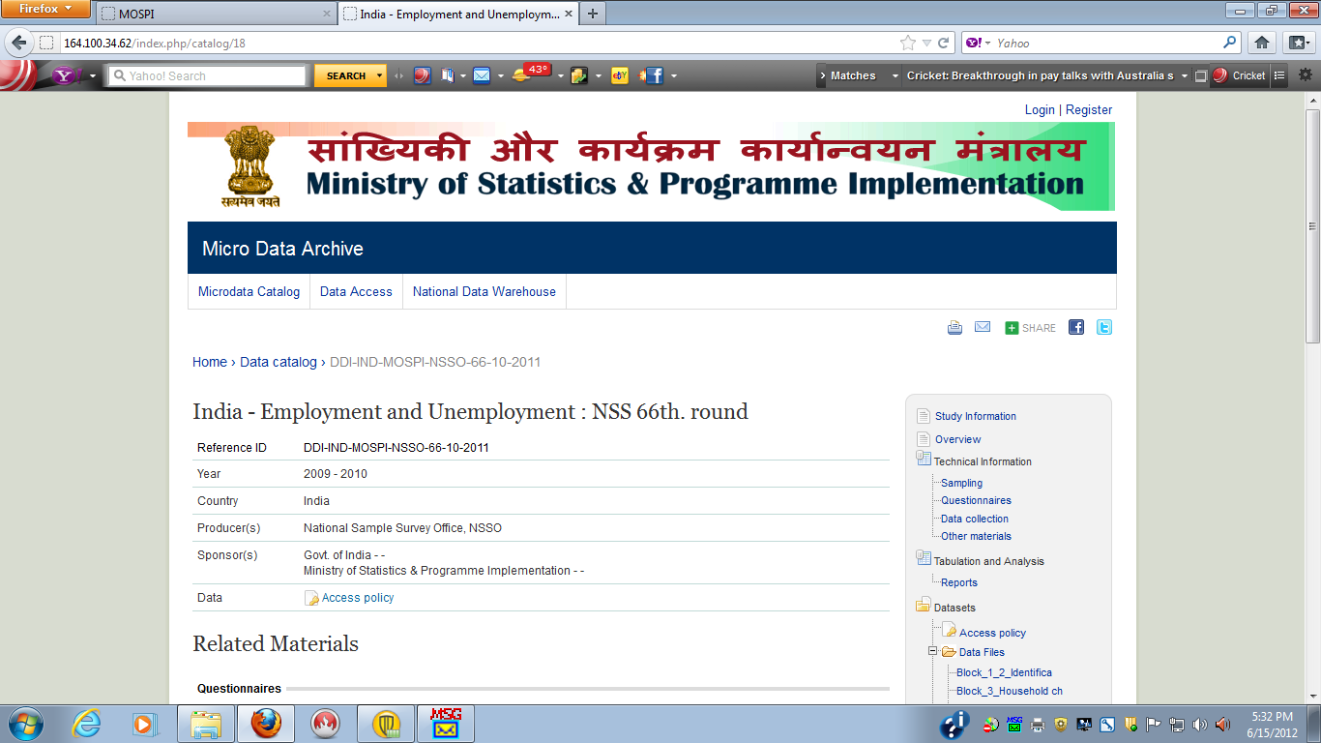

Slide 20
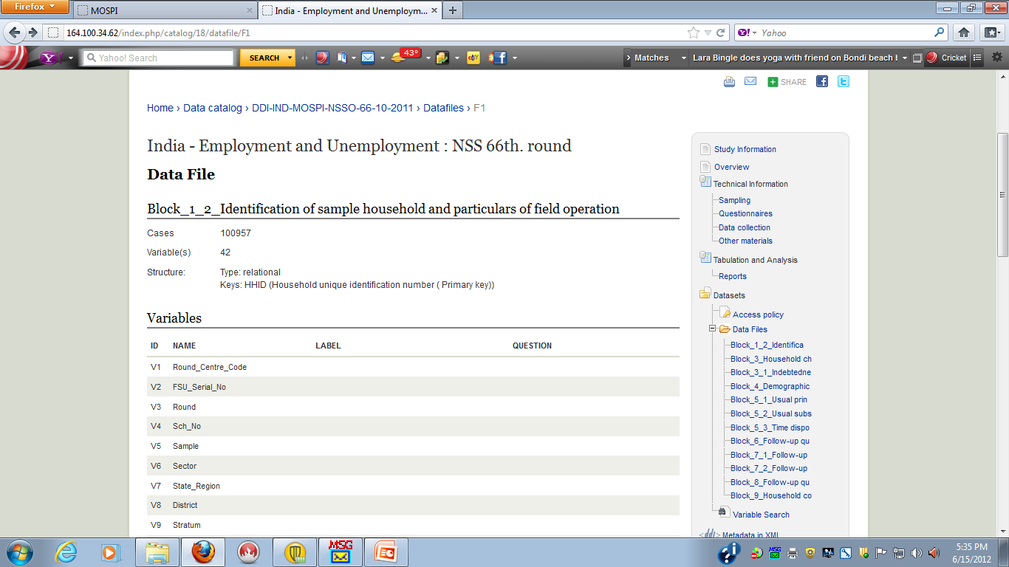

Slide 21
THANKS

